Slide 1





Welcome – we will begin shortly
Child Safeguarding Risk Assessment & Safeguarding Statement Webinar
12Ú Aibreán 2025
Please note your camera and microphone will remain switched off
Ask questions using the chat function/button on your screen
Please limit questions to the Risk Assessment and Child Safeguarding Statement process only
Stay connected – rejoin the webinar using the link emailed to you
Today's webinar will be recorded and be made available for you to watch again later

Slide 2
12ú AibrEÁN 2025 child safeguarding risk assessment & Safeguarding statement webinar 2025
GAA: Catherine Hibbitt safeguardingriskassessment@gaa.ie/catherine.hibbitt@gaa.ie
Camogie: Roberta Farrell roberta.farrell@camogie.ie
LGFA: Aislinn Harkin aislinn.harkin@lgfa.ie
Rounders: Craig Davis childrensofficer.rounders@gaa.ie
Handball: David Britton david.britton.handball@gaa.ie

Slide 3
Key Points
Opens 14th of April
Deadline 5.00pm 12th of May 2025 for Club and Counties
14th of May 2025 - non compliant clubs will be in breach of legislation and closure of clubs may be considered by Child Safeguarding Committee
Submissions must be made via Foireann

Slide 4
Learning Outcomes:
By the end of this Webinar, you will understand:
What is a Risk Assessment
Who must complete a Risk Assessment
How to prepare for the Risk Assessment
The difference between the optional Risk Assessment Template and the compulsory Risk Assessment on Foireann
How to complete the Risk Assessment
What is a Child Safeguarding Statement
How to download a Child Safeguarding Statement
The Compliance Process for the Risk Assessment

Slide 5
What is a risk assessment?
Through the provision of Gaelic Games, we are recognised as providing a relevant service for children
The purpose of the risk assessment is to consider the potential for harm, from a safeguarding perspective, that could come to children while in our care
A Risk Assessment & Child Safeguarding Statement must be completed at Club and County Executive/Management level every two years

Slide 6
Who must Complete a Risk Assessment?
Gaelic Games Association’s
All units (County and Club) who have members under the age of 18 (at Club and County Executive/Management Level)
Mandatory by Law in the 26 Counties
Rule Requirement for all including the 6 Counties and Britain
Mandatory for all under the joint Child Safeguarding Policy

Slide 7
Continued…
Within a Gaelic Games Club, i.e., where one overall Executive Committee operates then you are only obliged to complete one risk assessment procedure and develop one Child Safeguarding Statement for that club. (Eg One Club Model)
Where a Club has more than one Executive Committee, e.g., a GAA Committee, and Camogie or LGFA Committee, then each Committee (section) must complete their own risk assessment and develop a Child Safeguarding statement.

Slide 8
Please note:
Independent, combined and amalgamated teams or district teams are not mandated to complete the Risk Assessment or Safeguarding Statement.
The above teams should be covered by their Adult Club.
Can choose to complete the County Risk Assessment Optional Template and County Statement or agree their own Statement and forward to their County Children’s Officer.
Will not be completed on Foireann
Will not be noted as non-compliant

Slide 9
Who is Responsible for Completing the Risk Assessment
Clubs and Counties at Executive/Management Level
The Club/County Children’s Officer completes the Risk Assessment on Foireann

Slide 10
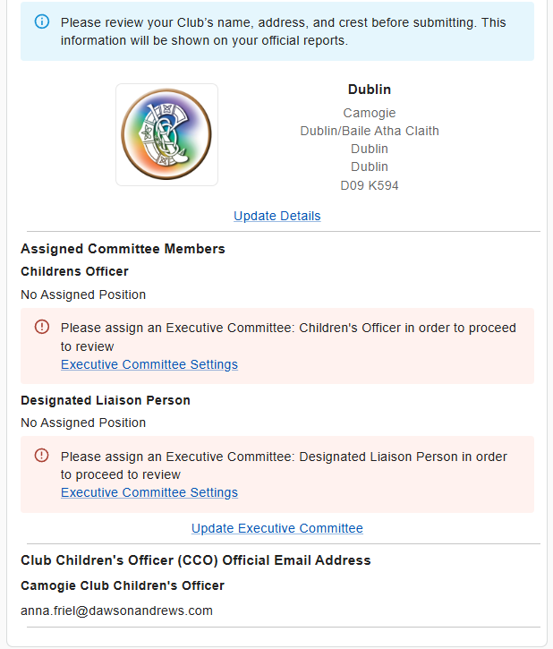
How to prepare for the risk assessment?
To Do List:
Please ensure your Club address is completed IN FULL on Foireann (Tusla Compliance Requirement)
Please ensure your Club Crest is visible on Foireann
Please ensure your Club Children’s Officer is named on the Executive list on Foireann, with an official email address
Please ensure your Designated Liaison Person is named on the Executive list on Foireann (do not require official email address)
If you are a One Club Model, please check you are Registered on Foireann as a One Club Model
Access the following link to assist in the updating of your Club Executive, if required: https://gmssupport.zendesk.com/hc/en-gb/articles/6842530008722-Executive-Committee
Please take the time to access the associated joint FAQ, and separate Club or County Guidance here.

Slide 11
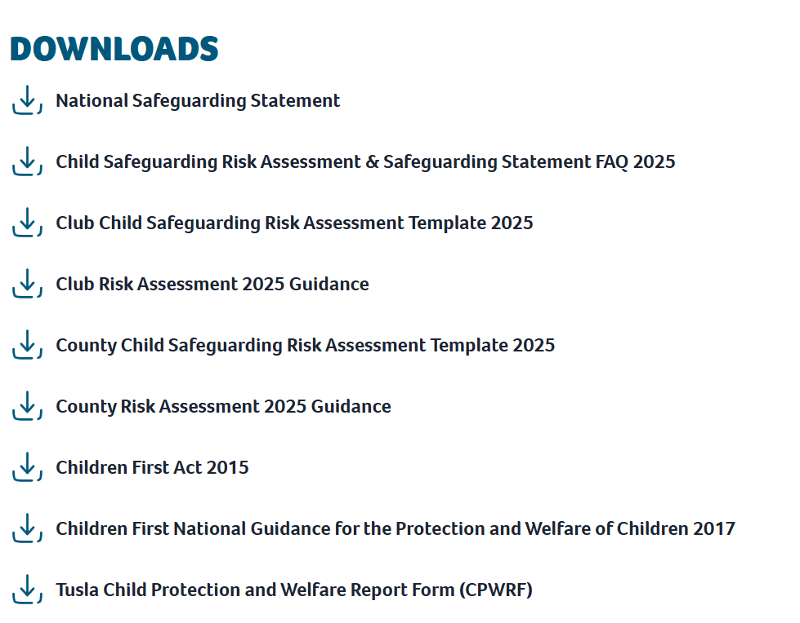
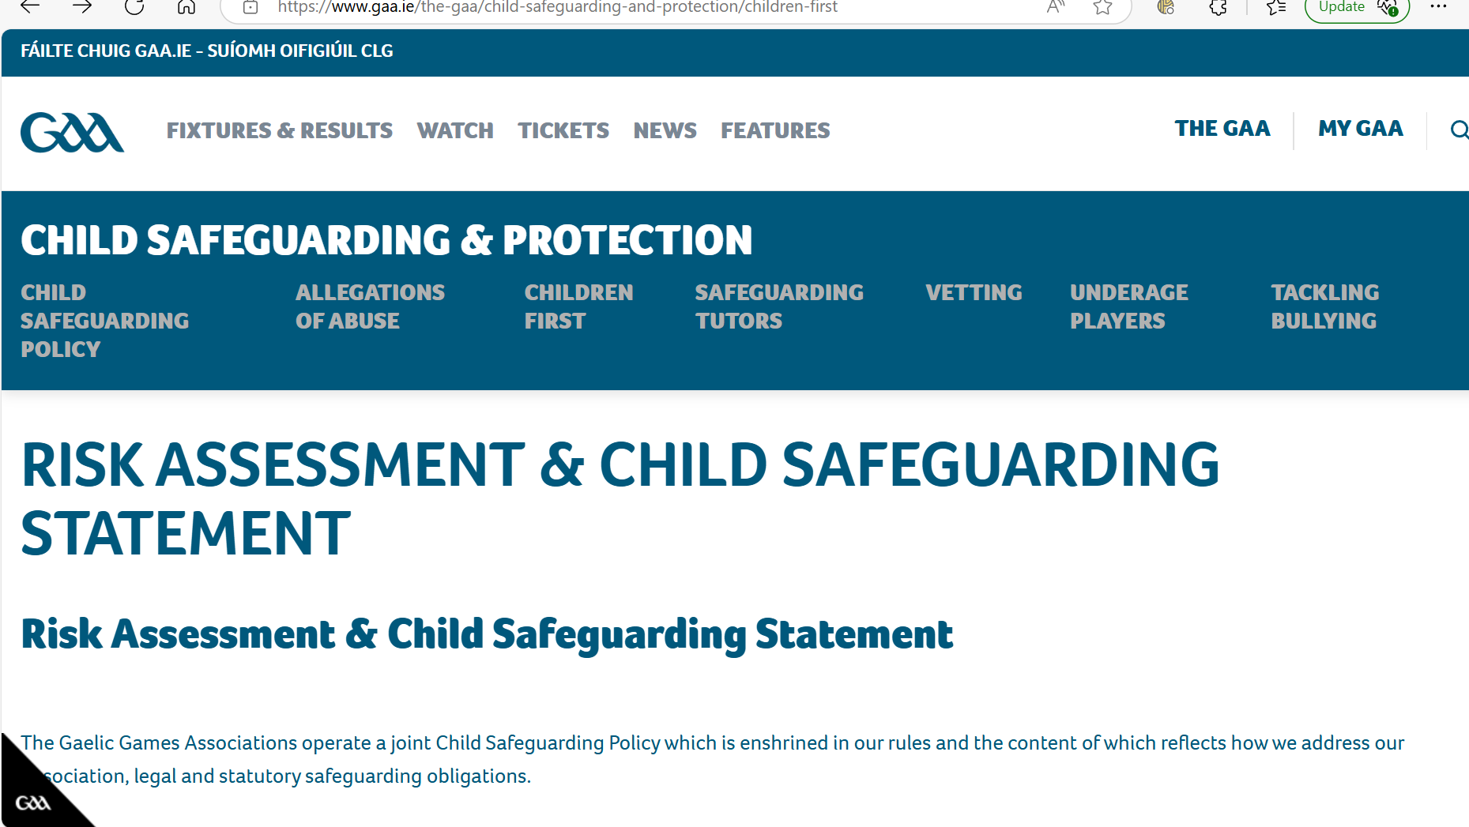
Where do I find the Optional Template, Club or County Guidance Documents and FAQ?
Risk Assessment & Child Safeguarding Statement

Slide 12
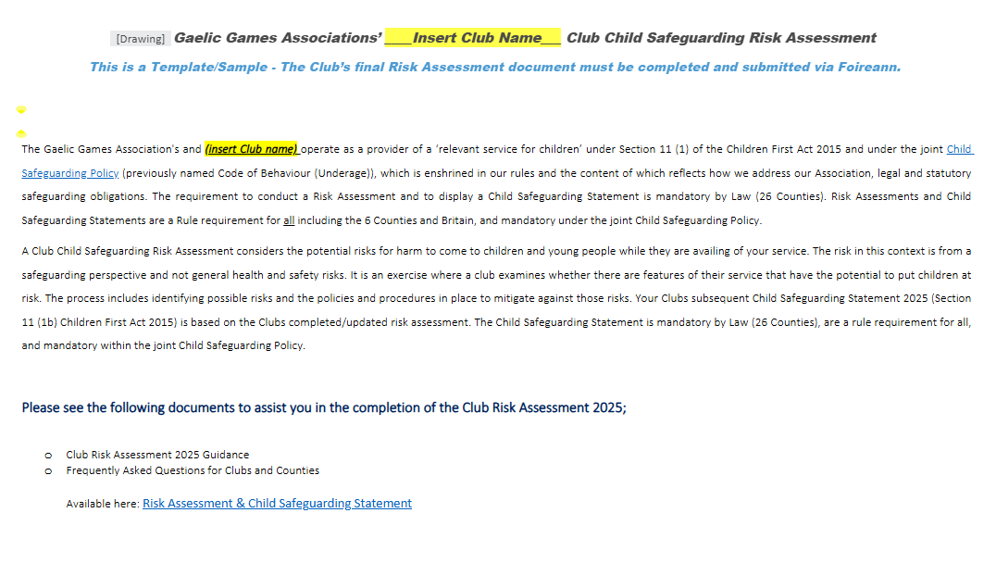
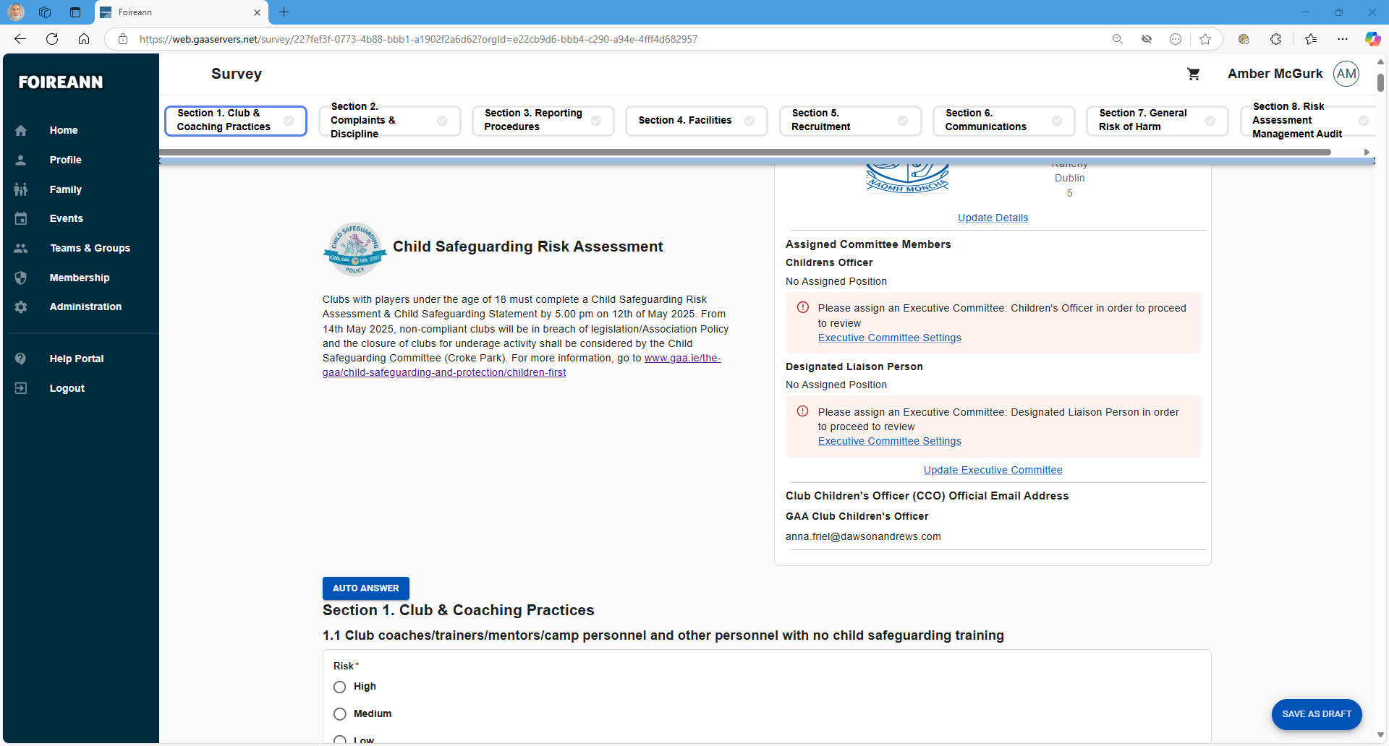
The Risk Assessment
Optional Template
Mandatory on Foireann

Slide 13
Risk Assessment Contents –
8 Sections
  Club/County and Coaching Practices
  Complaints & Discipline
  Reporting Procedures
  Club/County Facilities
  Recruitment
  Communications
  General Risk of Harm
  Risk Assessment Management Audit

Slide 14
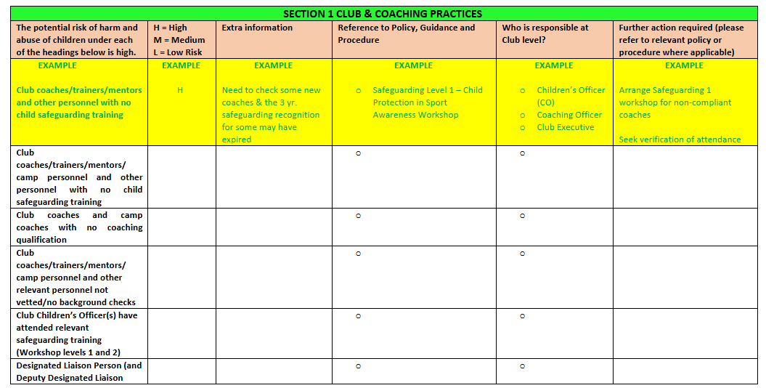
Optional Template

Slide 15
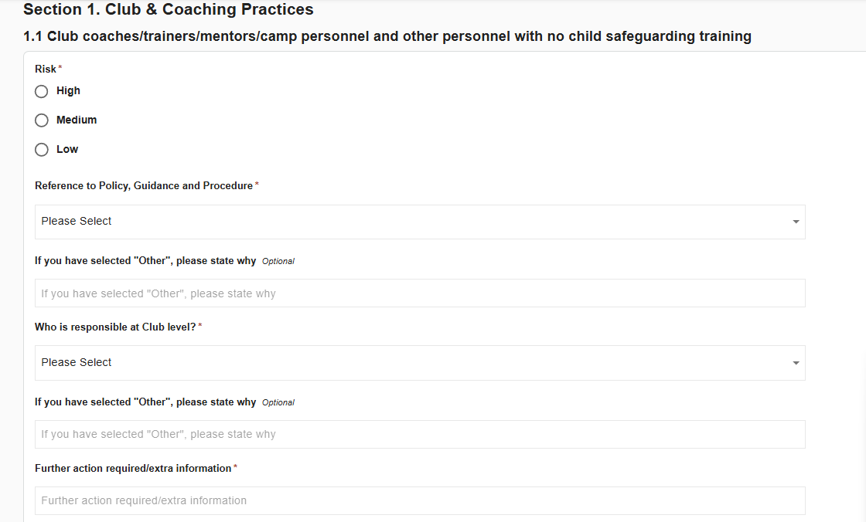
Mandatory - Foireann

Slide 16
Drop down options (Foireann)
'Reference to Policy, Guidance and Procedure’

Slide 17
Drop down options
Who is responsible at Club level?
  Children's Officer
  Designated Liaison Person (DLP)
  Club Executive
  National Safeguarding Committee
  Coaching Officer
  Mandated Person
  Coaches
  ‘Other’ (Ability for clubs to input)

Slide 18
Section 8 – Risk Assessment Management Audit (optional Template and Foireann)
Has your Club selected a 3-person Child Safeguarding Behaviour Hearings Committee? Yes/No
How many new* coaches were recruited by the Club in 2024 to work at underage level? (*not previously involved in the Club as a coach) (Insert figure)
Please provide the contact details of your Club Children’s Officer (Name/Email/Phone Number)
Please provide the contact details of your Club Designated Liaison Person (Name/Email/Phone Number)
In 2024, what were the most common issues that were brought to the attention of your Club Children’s Officer or your relevant Club Committee? Alleged breaches by coaches (underage); Alleged breaches by players (underage); Alleged breaches by parents or supporters; Transfer complaints; Complaints by parents over lack of playing time for their children; non-adherence to Vetting or Safeguarding Training requirements
If you selected complaints by parents over lack of playing time for their children what was the playing level? (Tick box answer, only one answer)

Slide 19
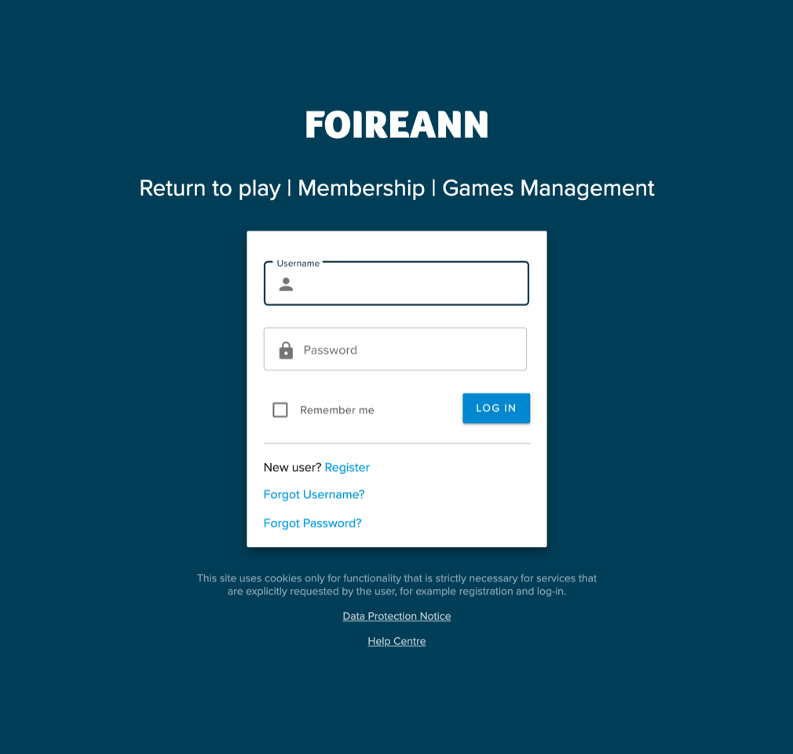
1. How to log into foireann
Go to foireann.ie and login using your Foireann account details.

Slide 20
2. How to assign access to your Club Children’s Officer
Navigate to ‘Membership’ section
Find member you wish to assign, tick beside their name and click ‘Member Actions > Assign Permissions’
Tick the checkbox beside the option 'Vetting Admin - Usually assigned to your club children's officer’ and 'Club Admin - Elevated privileges to administer your club members' then select ‘Assign Permissions

Slide 21
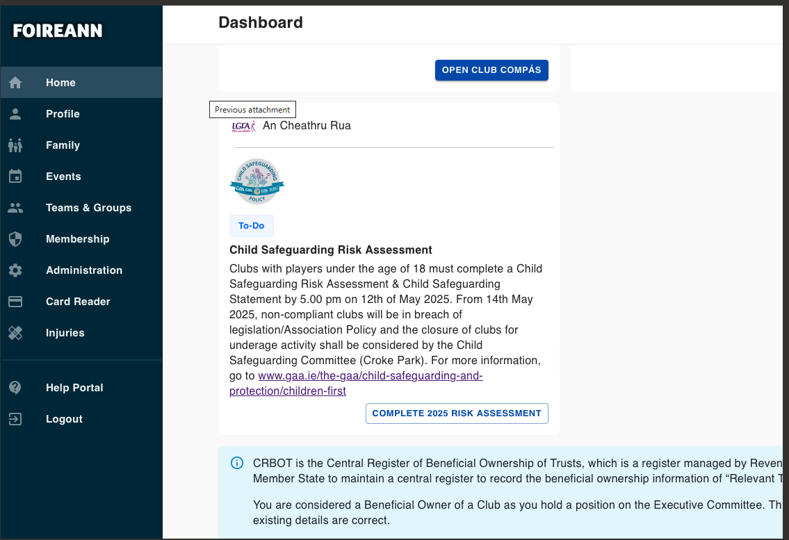
3. How to access the Risk Assessment/Safeguarding Statement on Foireann?
The Risk Assessment will be available on the Dashboard when the user logs into Foireann. They will need to be an Admin, Secretary or Children's Officer of a Club or County in Ireland or Britain.

Slide 22
4. How to complete the Risk Assessment
Upon clicking “COMPLETE 2025 RISK ASSESSMENT", the user will be presented with a form as below. Complete the steps as outlined
Members will be able to save their progress and complete the Risk Assessment in multiple sittings.

Slide 23
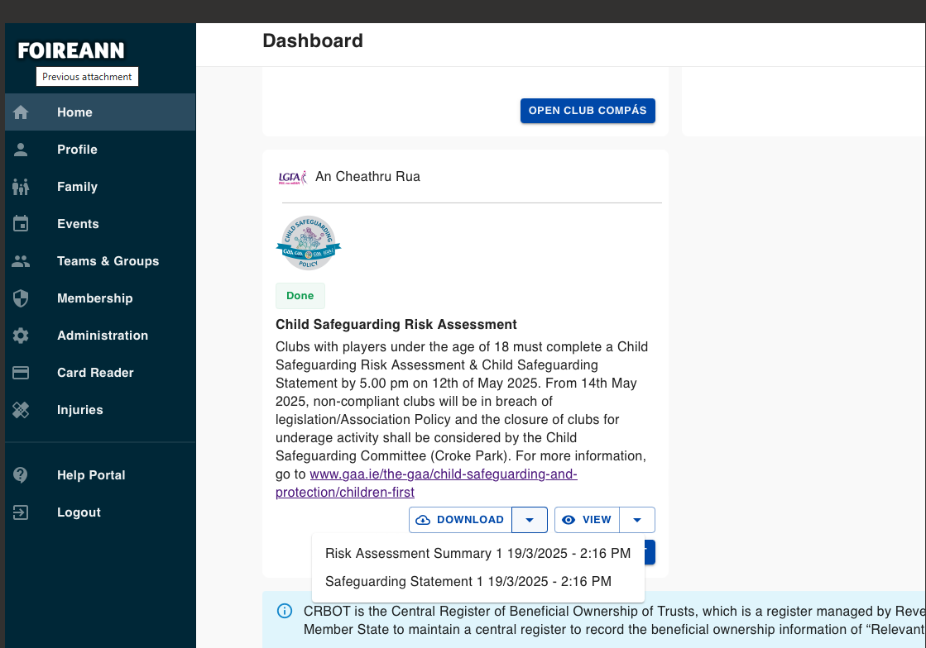
5. How to download a copy of your Risk Assessment/Statement
Upon completing all questions, you will be able to generate your reports and download them. Any previously completed reports will be available on the Dashboard via the "DOWNLOAD" button

Slide 24
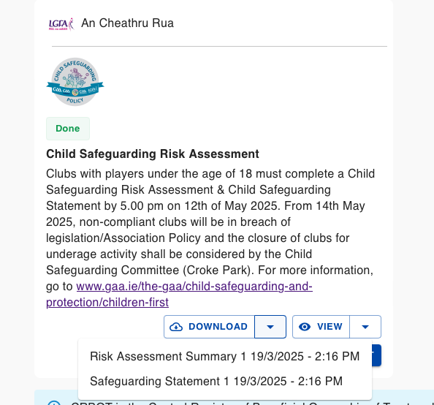
What is a Child Safeguarding statement?
A Child Safeguarding Statement is a written statement that specifies the service being provided and the principles and procedures to be observed in order to ensure, as far as practicable, that a child availing of the service is safe from harm. It should set out any potential risk of “harm” to a child that you have identified in your risk assessment, and procedures in place to reduce the identified risks.
Mandatory by Law (26 counties), in Rule and the joint Child Safeguarding Policy your Club/County Child Safeguarding Statement must be displayed in a prominent place and made available to parents and guardians, Tusla and members of the public upon request.

Slide 25
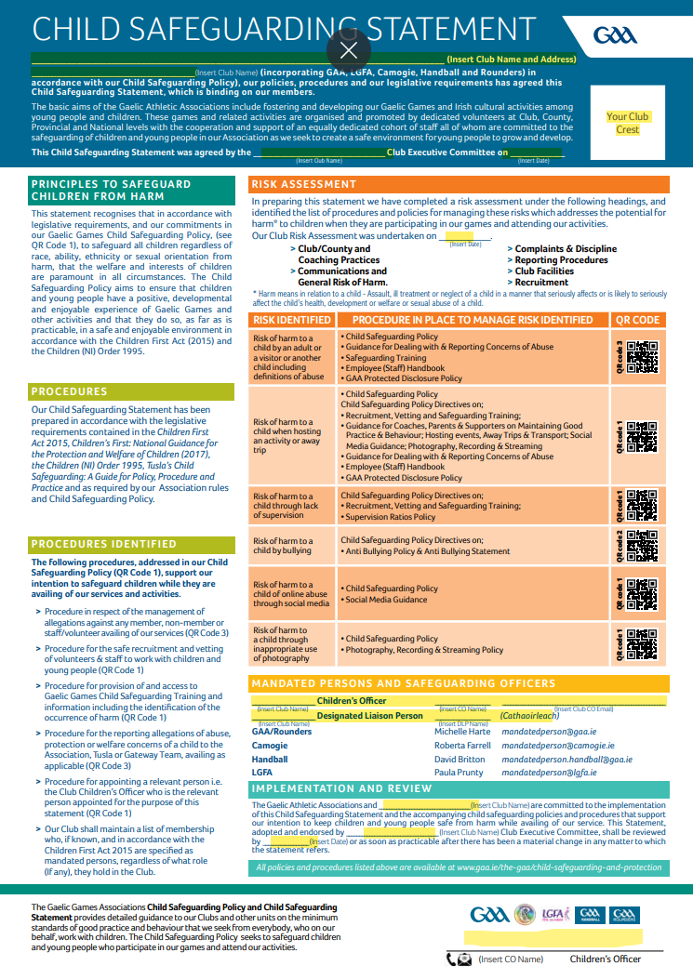
Child Safeguarding statement
The Children’s Officer is the Relevant Person who shall be the first point of contact in respect of the Child Safeguarding Statement
Information supplied via the Risk Assessment/Safeguarding Statement may be subject to a quality assurance follow up by Gaelic Games Associations or Statutory Authorities
Children’s Officers are required to input data (Club name, logo, address, Children’s Officer etc.)
Most areas are filled from info on Club/Counties Foireann’s account – but must be printed and signed by the Children’s Officer

Slide 26
Non compliance
Clubs should be reminded that under Sanction 5.14 of Section 4 of the Joint Child Safeguarding Policy (Dealing with and Reporting Allegations or Concerns of Abuse) that;
“The Child Safeguarding Committee shall also have the authority to order that a team, unit, or member, deemed to be safeguarding non-compliant, may not participate in any competitions, games, or activities during their period of non-compliance. This is a temporary measure and is separate to the process involving a Code of Behaviour Hearings Committee and shall be subject to the same appeals procedure as would any sanction imposed under the Code.”
Child Safeguarding Committee may suggest this sanction is imposed from 14th May 2025
Tusla will be undertaking compliance checks on 4 random Clubs in the 26 Counties over the summer period
Risk Assessments will form part the Safeguarding Compliance Audit Process for Clubs
Child Safeguarding Policy – Drop Down Option on Foireann – Complaints Procedure

Slide 27
Reminder - Key Dates
Opens 14th April 2025
Deadline 5.00pm 12th May 2025 for Clubs and Counties
14th May 2025 non-compliant clubs will be in breach of legislation and closure of clubs may be considered by Child Safeguarding Committee

Slide 28
Thank You
Questions?
Please limit questions to the Risk Assessment and Child Safeguarding Statement process only.
Should you have additional queries, please make contact with your Gaelic Games Association.

